Slide 1
Venue Characteristics Near the Rapid Transit Stations and Their Relationship to the Ridership
Siyu Lin
December 27, 2020

Slide 2
Introduction
Metro Vancouver is expected to accommodate an additional 1 million resident and 500,000 jobs by 2040, but the road infrastructure cannot handle so much growth – the transit network is the solution.
The transit agency needs to grow the ridership to maintain their financial sustainability. If we can show them the type of business around the stations with high ridership, the transit agency can develop policy that promotes the type of business stimulating the ridership growth around the transit stations.

Slide 3
Data Sources
Rapid Transit Station Locations (GTFS)
Venue Database (Foursquare API)
Transit Ridership (2017 TSPR)

Slide 4
Rapid Transit Station Locations
Source: TransLink GTFS Data
Rapid Transit Services
SkyTrain
SeaBus
West Coast Express

Slide 5
Venue Database
Source: Foursquare API
Example: Coquitlam Central Station
Data queried for each station
Catchment area of 400m
Venue Database Attributes:
Transit Stop (the query location)
Venue ID
Venue name
Venue type
Venue location (latitude, longitude)

Slide 6
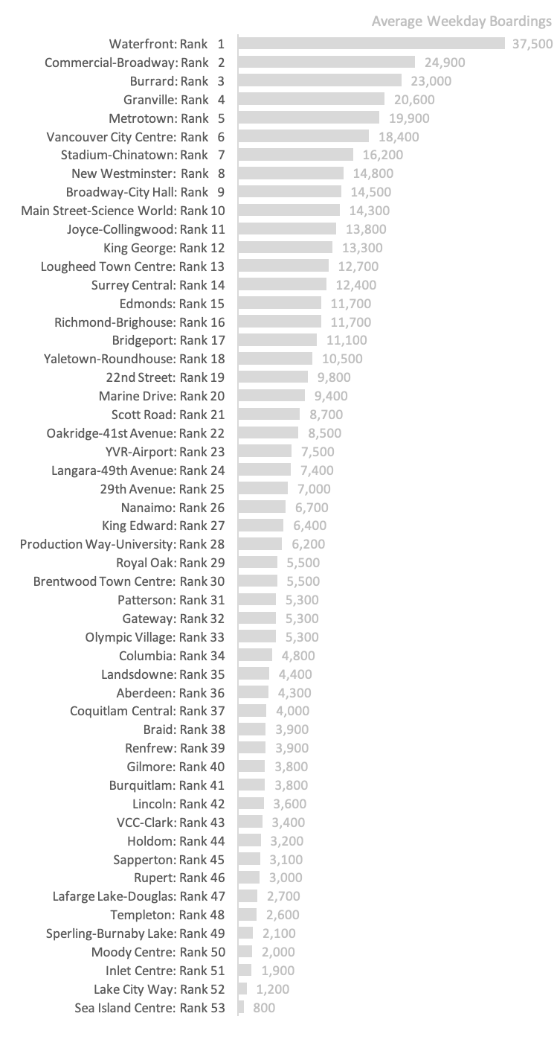
Transit Ridership
Source: TransLink 2017 TSPR
The stations are ranked by ridership (measured by average weekday boardings):
Waterfront Station has the highest ridership
Sea Island Centre ranks the last
…

Slide 7
Methodology
Data collection
Create the station clusters based on the surrounding venue types
Summarize the cluster patterns and review their relationship to the ridership ranking

Slide 8
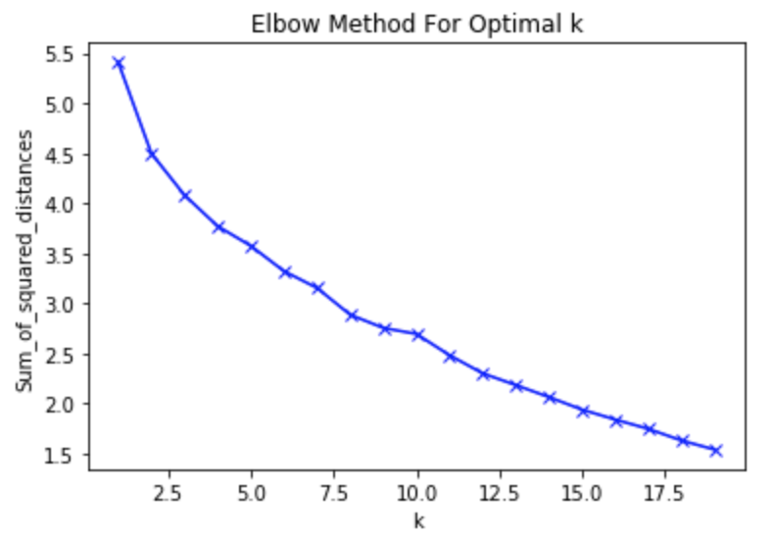
K-Mean Clustering the Rapid Transit Stations
Three station groups are created using the k-mean clustering algorithm
The attributes are the top ten venue categories (by frequency) for each station

Slide 9
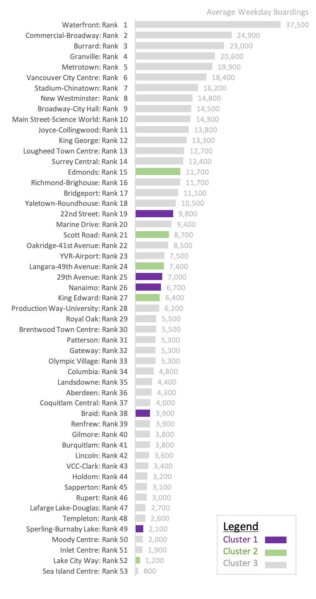
Result
The first cluster is dominated by the bus stop
The second cluster is surrounded by park and light rail station
The third cluster is “everything else”
The first two clusters are in less-dense part of the region

Slide 10
Discussion
There is no obvious pattern in the type of business and the ridership performance. The business near the station such as the coffee shop and the bank might trigger an intermediate stop but these are not a rider’s final destination.

Slide 11
Conclusion
The business types surrounding the transit station do not have an impact on the transit ridership.
The transit agency should not focus on business development policy surrounding one station to stimulate the ridership growth.

